Slide 1
Respiratory Disorders
By: Justin Minnich

Slide 2
Facts
About 35 million Americans suffer from a respiratory disorder
Respiratory disorders are the #3 killer in America
Respiratory disorders are more common in African Americans
On average 1 out of 10 school-aged children have asthma

Slide 3
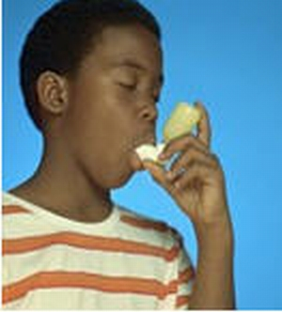
Respiratory Disorder
Condition that leads to insufficient supply of oxygen to the lungs and the retention of carbon dioxide in the body.

Slide 4
Most Common Disorders
Asthma
Hay Fever
Cystic Fibrosis
Chronic Bronchitis

Slide 5
Asthma
The disease of the bronchiole by swelling of mucus membrane lining the bronchial tubes.
Symptoms
Coughing
Wheezing
Constriction of chest

Slide 6
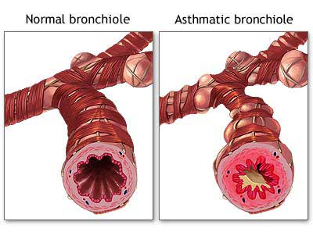

Slide 7
Hay Fever
The allergic disease caused by a sensitivity to specific substances in the air. Effects sleep and appetite. There is no cure for hay fever.
Symptoms
Sneezing
Watery eyes
Running nose

Slide 8
Cystic Fibrosis
The abnormality or inadequacy of some hormone that affects the excretion of mucus, saliva, and perspiration.
Symptoms
Abnormal amount of saliva and perspiration

Slide 9
Chronic Bronchitis
The serious disease that interferes with breathing.
Symptoms
Shortness of breath
Sufferer coughs
Causing lots of phlegm

Slide 10
Treatments
Inhalers
Nebulizer
Surgeries
Remove thick mucus from lungs

Slide 11
Things YOU can do
Proper warm-up
Proper cool-down
Aerobic fitness
Swimming
Avoid running in cold air
30-40 minutes of activity
4-5 times per week

Slide 12
References
Dunn, J.M., & Leitschuh, C.A. (2009). Special physical education (9th ed.). Dubuque, IA: Kendall Hunt.
The Ohio State University Medical Center. About Respiratory Disorders. Retrieved April 8, 2010. http://medicalcenter.osu.edu.
University of Maryland Medical Center. Respiratory Disease (2008, January 18). Retrieved April 8, 2010. http://www.umm.edu.

