Slide 1
Medical Care
By: Justin Minnich

Slide 2
Chapter objectives
Know how elders get income
Know financing of medical care
Understand the problems associated with medical care

Slide 3
Discussion #1
What kind of medical care do your grandparents get? How do they pay for it?

Slide 4
Elders’ Source of Income
Social Security
Supplemental Security Income (SSI)
Pensions
Assets (savings, home equity)
Previous earnings

Slide 5
Social Security vs. Supplemental Security Income
Social Security
Guaranteed monthly income to individuals 65 and older, who paid into the program while working.
48 million people benefit from social security
Men receive around $1100 per year
Women receive around $900 per year
Supplemental Security Income
If Social Security benefits are insufficient to cover living expenses, public assistance is available from the SSI
Covers people who are aged, blind, or permanently disabled
7 million people are covered by SSI, 2 million are elders

Slide 6
Financing Medical Care
Medicare
Supplemental health insurance
Medicaid
Department of veterans affairs
Indian health service
Out-of-pocket

Slide 7
Discussion #2
What are some of the things that Medicare covers?

Slide 8
Medicare
Billions of dollars are spent each year on Medicare
The money comes from taxes
When you reach 65 years of age you are automatically eligible
Covers
Hospital Care | Nursing Homes
Prescriptions | Homecare*

Slide 9
Discussion #3
Name some problems associated with medical costs.

Slide 10
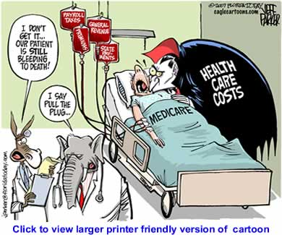
Limitations of Medicare
Does not cover
Home care
Dental care
Vision and glasses
Hearing exams
Hearing aids
It can be confusing
Need for health care is growing, while Medicare is shrinking
More people need health care, health care is more expensive

Slide 11
Medicaid
Works similar to Medicare, only for the poor
Eligibility is based on monthly income
Works for both elders and non elders
Each state is different
http://www.youtube.com/watch?v=QZ_cEkxEXFE

Slide 12
Discussion #4
How do you feel about paying taxes for Social Security, Medicare, Medicaid, and other government services?

Slide 13
Problems with Health Care
High costs
Technology is more advanced making costs go up
For profit medical care
Large corporations
Inequities in treatment
Income, race, gender, age
Inaccessible services
Traveling, going from doctor to doctor
Lack of training in geriatrics
Growing number of elders
People aren’t interested in working with elders

Slide 14
Discussion #5
What do you think is the single most concern with health care?

