Slide 1
Demonstration Report for Jeff Osborne of CHEM-405 Biochemistry I
If you wish, you may copy this demonstration and insert your own content.

Slide 2
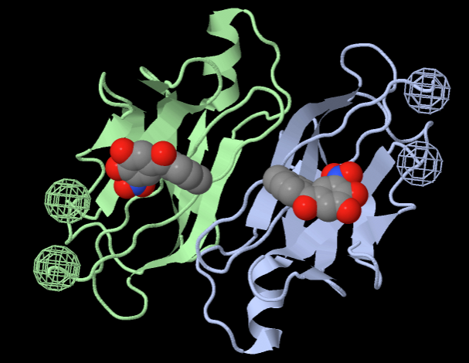
Section 1: Identity. Report for CHEM-405 Biochemistry I
Jeff Osborne (Put YOUR NAME here!)
4d7b
Human transthyretin complexed with the drug tolcapone.
Transport thyroxin, retinol; involved in amyloid diseases.
X-ray crystallography, resolution 1.15 Ångstroms.

Slide 3
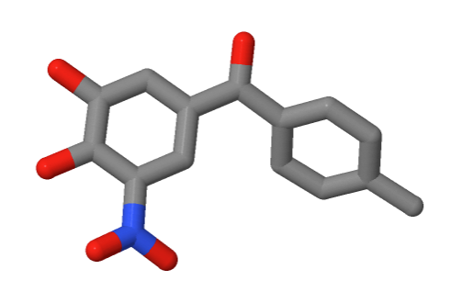
Section 2: Composition
Protein chains: 2
DNA chains: 0
RNA chains: 0
Ligands
TCW: Tolcapone
Non-Standard Residues
(None)
*
C, O, N
* Snapshot is not required. To get it for extra credit: Isolate, Residue, click on ligand, Views tab: Vines/Sticks, zoom in.

Slide 4
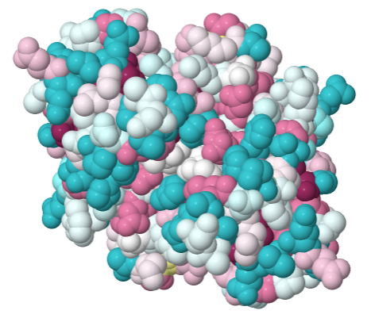
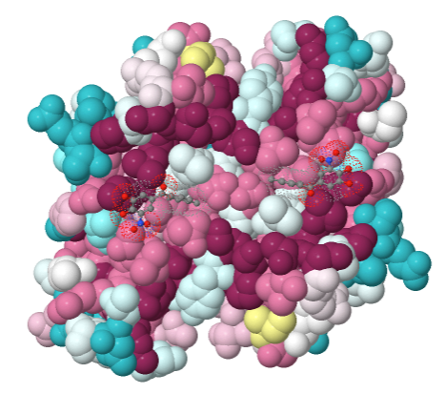

Section 3A: Evolutionary Conservation
If you do your own job at the ConSurf Server, be sure to paste its web address (URL) into this slide.
http://consurf.tau.ac.il/results/1454802686/output.php
The ligand-binding side is much more conserved than the opposite side.
Side not binding ligand.
Side binding ligand.

Slide 5
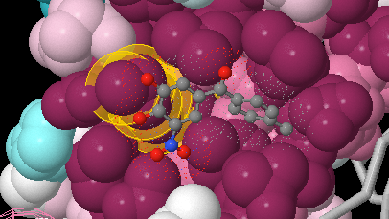
Section 3B: Evolutionary Conservation.
Conservation of Lys15 and contact with ligand.
Lysine 15 is identified with yellow halos (using Find in FirstGlance). This snapshot shows that Lysine 15 is highly conserved, and that its sidechain contacts the ligand tolcapone (ball and stick) near its hydroxyls (red oxygens).

Slide 6
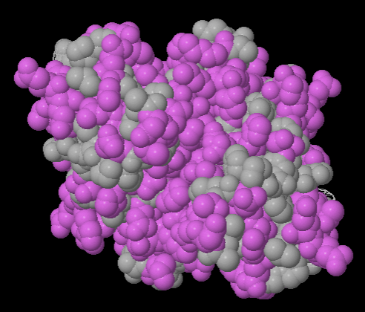
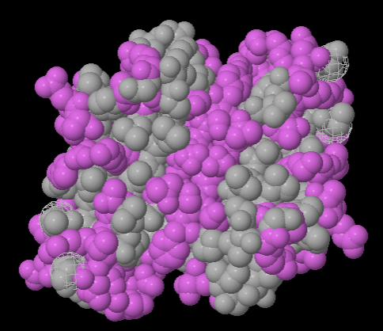
Section 4: Hydrophobic/Polar
This protein has a mostly polar surface, consistent with it being water soluble. There are no large hydrophobic patches on its surface.
Hydrophobic
Polar/Charged
Side not binding ligand.
Side binding ligand.

Slide 7
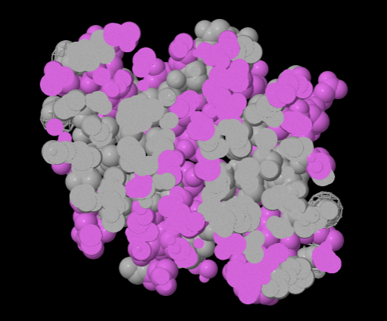

Section 5: Hydrophobic Core
Each domain has a hydrophobic core (circled in red).

Slide 8
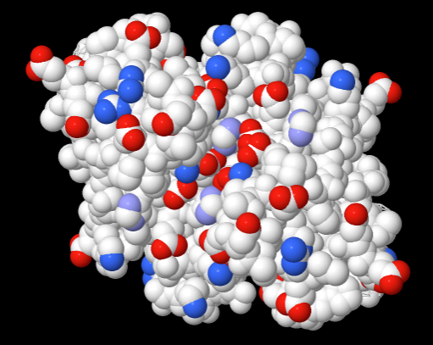
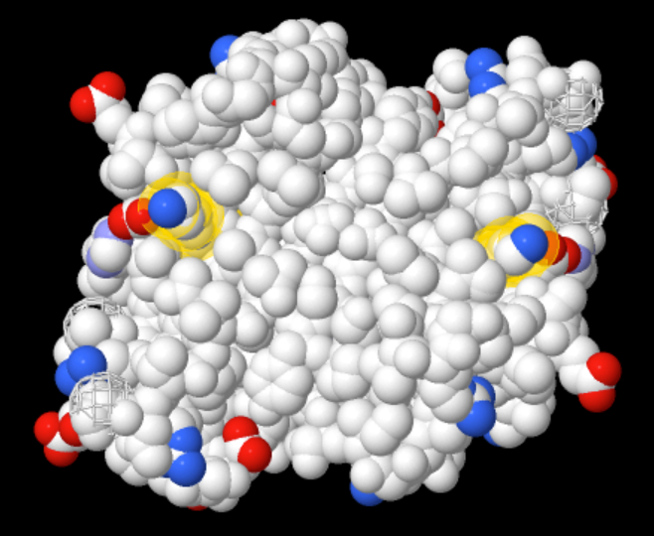
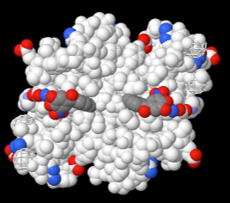
Section 6: Charge
Cationic +
Anionic -
The ligand-binding side is largely devoid of charge. The side not binding ligand has many charges, but no large regions that are all negative or all positive.
Showing ligands bound.
Side not binding ligand.
Side binding ligands. Lysine 15 is marked with yellow halos (see Section 11D)

Slide 9
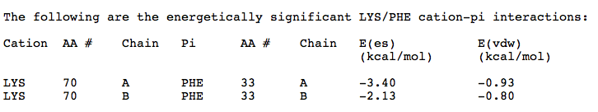
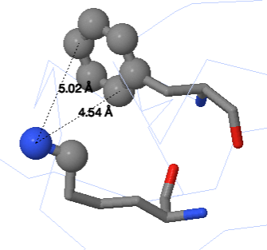
Section 7: Cation-Pi Interaction
Phe33 chain A
C, O, N
Lys70 chain A

Slide 10
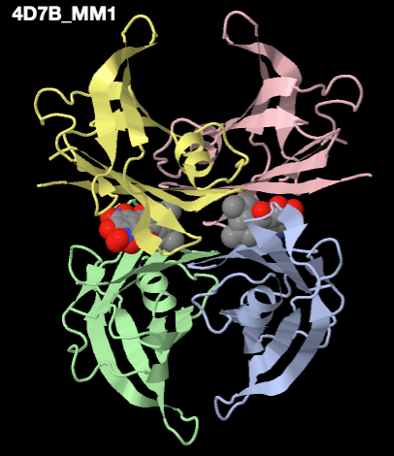
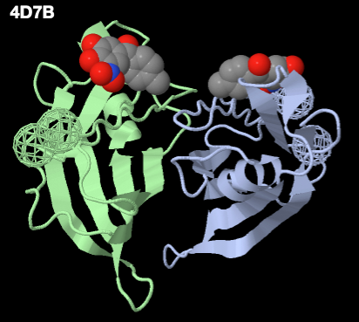
Section 8: Biological Unit
The published PDB file (asymmetric unit) has 2 chains.
MakeMultimer: 4 chains. Authors believe the functional form of the molecule is a homo-tetramer.
1D66_MM1
Asymmetric Unit: 2 chains
Biological Unit: 4 chains

Slide 11
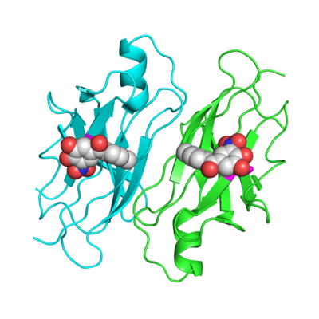
Section 9: Animation from Polyview-3D
Lysine 15 is hydrogen-bonded to the oxygens in the ligand (tolcapone, shown spacefilling in red and white). Lys15 is highly conserved (Sect. 3B). It is highlighted in magenta.
This 400 pixel animation spins through 360 degrees in 2 degree steps, with a 5/100 second delay.

Slide 12
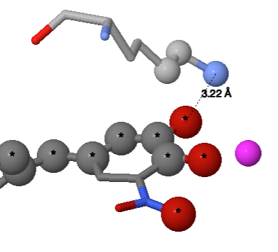
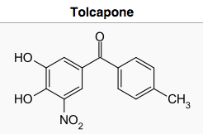
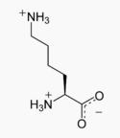
Section 10: Noncovalent Bonds
Nitrogen of Lysine 15 is hydrogen-bonded to an oxygen on the ligand Tolcapone. Both the nitrogen and the oxygen have hydrogens*, but since the model lacks hydrogens, it is unclear which is the donor and which is the acceptor.
C, O, N
Lysine 15
Ligand: Tolcapone
Water
*If only one partner has hydrogen, then it must be the donor.
(Chemical structures from Wikipedia)

Slide 13
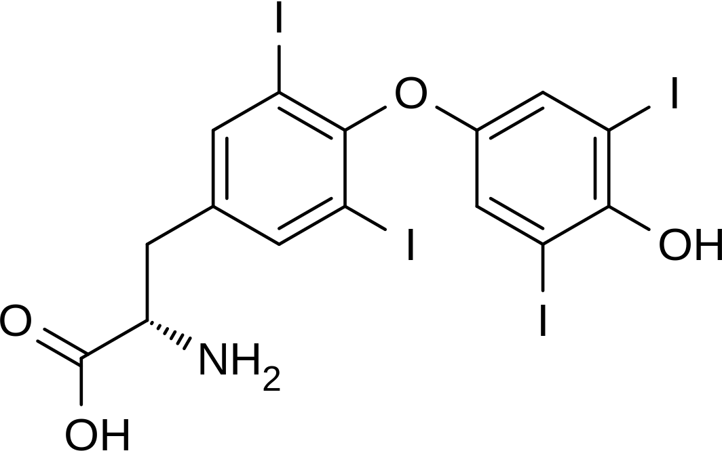
Section 11A: How Structure Supports Function
4d7b is a model of human transthyretin (transfers thyroxin and retinol-binding protein complexed to retinol¹) complexed with the drug tolcapone. Tolcapone has similarity to thyroxin T4, a physiological ligand for transthyretin.
Thyroxin T4
Chemical structures from Wikipedia.
(Continued on next slide.)

Slide 14
Section 11B: How Structure Supports Function.
Background for tolcapone ligand
The ligand in 4d7b, tolcapone⁴, was approved by the FDA in 1998². It is used in combination with other drugs to treat Parkinsonian diseases³.
Mutations in transthyretin cause another disease of the nervous system, amyloidosis⁵. Tolcapone has been designated an orphan drug by the FDA⁶. Orphan drugs may be useful for treating conditions so rare that drug companies have no financial incentive to develop and market them. Clinical trials of tolcapone for hereditary transthyretin amyloidosis are underway⁷, as well as for other diseases and conditions⁸.

Slide 15
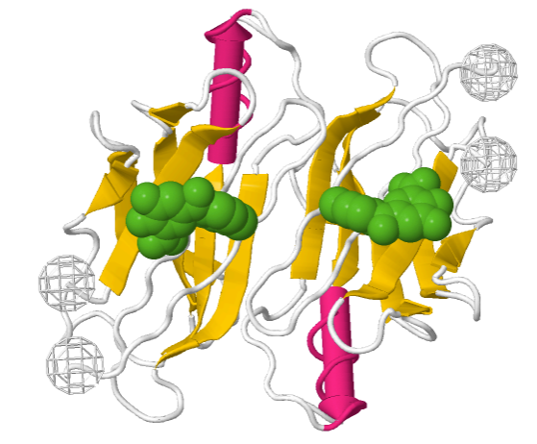
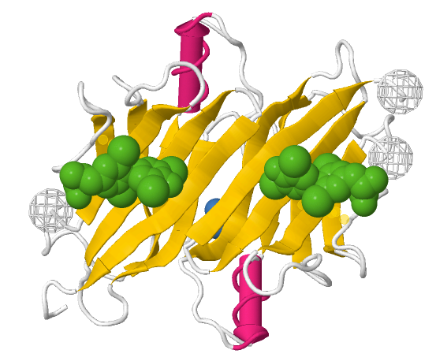
Section 11C: How Structure Supports Function.
Ligand binding sites.
A search for thyroxin T4 in the Protein Data Bank (pdb.org) revealed that it is coded “T44” there, and turned up a model of human transthyretin complexed with T44, PDB code 2rox. Comparison with the subject of this report, 4d7b, reveals that the drug and the natural ligand thyroxin bind to the same location on the protein. Lysine 15 contacts both ligands (see Section 10 for 4d7b; not shown here for 2rox.).
Tolcapone bound to human transthyretin (4d7b).
Thyroxine T4 bound to human transthyretin (1rox).

Slide 16
Section 11D: How Structure Supports Function.
Protein Structure vs. Ligand Binding.
Transthyretin folds into a stable domain with a ligand binding site. Both ligands (see Section 11A) have two hydrophobic phenyl rings. The paucity of charges where these ligands bind (see Section 6) appears to facilitate the binding of the hydrophobic portions of these ligands.
Both ligands also have hydroxyl or carboxyl groups that have negative (or partially negative) charges, and will bind to positive charges. Lysine 15 is a positively charged, highly conserved amino acid in the binding site that accommodates this need (see Sections 3, 6, 9 and 10).
The binding site is rather flat, which may make the binding weak enough to release the ligand at the destination after transporting it. In the biological unit (Sec. 8), four copies of the protein chain hold the ligand in a box-like container.

Slide 17
Section 11E: Sources
https://en.wikipedia.org/wiki/Transthyretin
http://www.accessdata.fda.gov/scripts/cder/drugsatfda/index.cfm?fuseaction=Search.Set_Current_Drug&ApplNo=020697&DrugName=TASMAR&ActiveIngred=TOLCAPONE&SponsorApplicant=VALEANT%20PHARMS%20LLC&ProductMktStatus=1&goto=Search.DrugDetails
http://www.webmd.com/drugs/2/drug-5074/tolcapone-oral/details
https://pubchem.ncbi.nlm.nih.gov/compound/Tolcapone
http://ghr.nlm.nih.gov/condition/transthyretin-amyloidosis
http://www.accessdata.fda.gov/scripts/opdlisting/oopd/OOPD_Results_2.cfm?Index_Number=413913
http://www.ncbi.nlm.nih.gov/pmc/articles/PMC4642128/
https://clinicaltrials.gov/ct2/results?term=tolcapone

