Slide 1
The following slides demonstrate molecular animations generated with the PolyView3D server.
FirstGlance.Jmol.Org

Slide 2
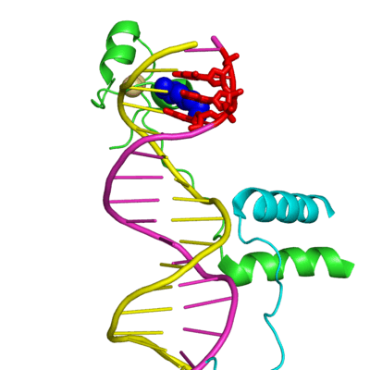
Gal 4 Transcriptional Regulator Protein.
DNA Double Helix (Chain / Chain).
Lysine 18 sits in DNA Major Groove
recognizing CGG.
Martz – May 2010 – 1d66

Slide 3
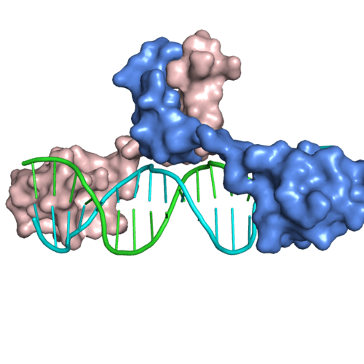
Animation Created by Polyview-3D
(using PyMOL)
Martz – May 2010 – 1d66

Slide 4
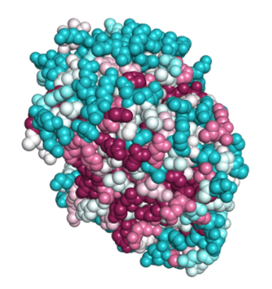
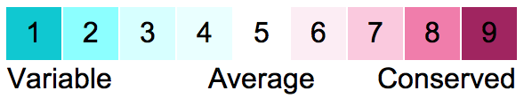
Enolase (4enl) colored by evolutionary conservation with ConSurf.
360° rotation by PolyView-3D with PyMOL.
FirstGlance.Jmol.Org

Slide 5
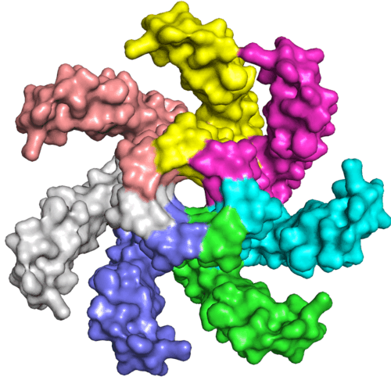
Mechanosensitive channel
Animation by Polyview-3D using PyMOL
(Morph between 2oau & 2vv5)
FirstGlance.Jmol.Org

Slide 6
PolyView3D:
While in FirstGlance, click on How? next to Copy this view and paste it into a presentation, at the bottom of the lower left panel.
ConSurf:
Evolutionary Conservation in the Resources tab of FirstGlance.
Morphs:
At Proteopedia.Org, search for Morphs. That article explains how to make them.
FirstGlance.Jmol.Org

