Slide 1
Arthritis
By Matthew Landrum

Slide 2
Ice!!
I would like you to put your hand in the bag of ice until the end of my presentation to simulate not being able to use your hand.

Slide 3
Definition
A medical condition affecting a joint or joints, causing pain, swelling and stiffness.
The break down of cartilage. Cartilage normally protects the joint, allowing for smooth movement.
Cartilage also absorbs shock when pressure is placed on the joint, like when you walk. With out the normal amount of cartilage, the bones rub together, causing pain

Slide 4
Different types of Arthritis
Rheumatoid arthritis: Disorder that is believed to result from an "autoimmune" process in which the body's immune system attacks itself.
Psoriatic arthritis: a form of rheumatoid arthritis usually affecting fingers and toes
Reactive arthritis: joint problems triggered by bacterial or viral infection elsewhere in the body

Slide 5
Types Cont.
Septic arthritis: Bacterial infection of one or more joints; requires urgent diagnosis and treatment.
Inflammatory arthritis: the membrane that lines the joint becomes inflamed, producing pain and swelling.
Juvenile arthritis: Childhood arthritis, AKA Still’s Disease.

Slide 6
Types Cont.
Degenerative arthritis: The wearing away of cartilage that protects and cushions joints including those in the spine, hands and feet.

Slide 7
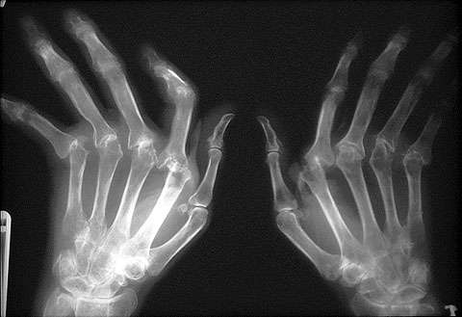
Age range of the effected
Arthritis can affect anybody.
More likely in older people.

Slide 8
From Doctor Point of View
What is Arthritis? Video

Slide 9
Treatment
Popping of joints relieves the pressure.
Medication.
Ice/Heat
Acupuncture
Magnets
Massage
Tai Chi/Yoga
Supplements such as fish oil

Slide 10
Throwing a ball
Now that you have had your hand in the ice lets see how easy it is to use that hand.

Slide 11
References
http://arthritis.about.com/od/arthritistreatments/a/treatment.htm
http://www.google.com/webhp?sa=N&tab=lw#hl=en&source=hp&q=arthritis+definition&aq=4&aqi=g10&aql=&oq=arthritis+d&gs_rfai=&fp=50954f7df8d7ab63

