Slide 1

Medication Use

Slide 2
Discussion Question #1
“Drugs represent one of the classical conundrums of life. We can’t live with them; we can’t live without them.” –John E. Morley-
What does this quote mean to you?

Slide 3
Background Information
A medication is a substance that treats, prevents, or reduces the symptoms or the progression of a disease.
Medications are available in many forms. Most of us think of pills, capsules, or liquids, but medications can also be inhaled, applied to the skin, placed in the rectum, vagina, eye, or ear, placed under the tongue, or injected in the skin or deep into the muscle.

Slide 4
Background Information Continued
Drugs may be sold in two ways; by prescription or over-the-counter.
All medications have risks and benefits, and all have side effects, symptoms or problems that are not intended.

Slide 5
Elderly Adults; Prevalence of Medication Usage
The National Health and Nutrition Examination Survey reported that 84 percent of individuals 65 years of age and older used at least one prescription medication in the past month, and almost half used at least three.
Older women reported higher drug use than older men.
Ethnicity affects drug use: blacks used more prescription drugs than whites, and Mexican Americans used the least.
In 2004, the most common health conditions for which drugs were prescribed were high cholesterol, high blood pressure, and pain relief.

Slide 6
Discussion Question #2
How many of your grandparents take medications? What are their aliments? How do they pay for the medications?
http://www.youtube.com/watch?v=EniVhiOc8RE

Slide 7
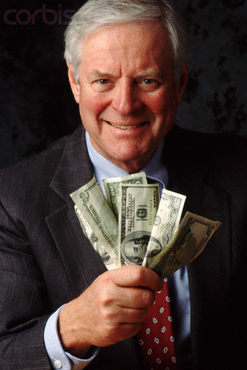
Elder Medication Use and Cost
High drug use leads to high total drug costs. The proportion of the health care dollar spent on prescription drugs continues to rise faster than inflation. In a 13-year period from between 1990 and 2003, the nation’s expenditure on prescription drugs increased more than four times, from $40 billion to $180 billion.
This equates to a average yearly cost of $2,322 for individuals 65 and older.

Slide 8
Ways for Paying for Medications
Medicaid
Medicare
A program funded by the federal and state governments that pays for medical care for those who can’t afford it.
Out of Pocket
Individuals provide payment from savings and earnings.
A federal program that pays for certain health care expenses for people 65 and older.

Slide 9
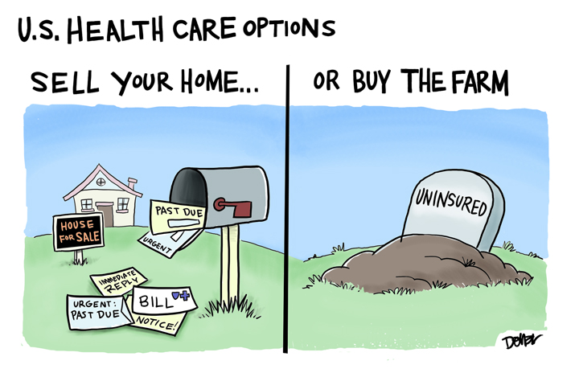
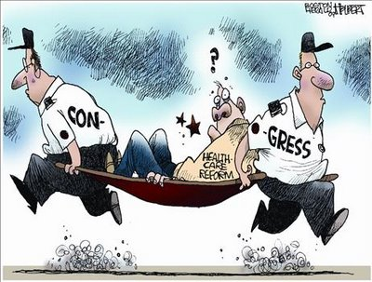
Health Care Cartoons

Slide 10
Discussion Question #3
Medications are much more expensive in the United States than in other countries, and American pharmaceutical companies report some of the largest financial earnings each year. With this being said do you believe Eli Lilly’s donation to Manchester is out of generosity or a future business move for their company?
http://www.youtube.com/watch?v=OZBPaazJXT0

Slide 11
Generic Versus Brand Name Drugs
When a pharmaceutical company develops a new drug, it is patented and sold only by that company under a single brand name. The patent expires after 20 years after which time any drug manufacturer can apply to the FDA to sell a generic form of the medication.
According to data from the National association of Chain Drug Stores, in 2004 the average price of a brand name prescription was approximately $96.01, and the average price of a generic prescription was approximately $28.74 a savings of $67.27 per prescription.

Slide 12
Discussion Question #4
Would you personally buy generic drugs over brand name drugs? Why?
http://www.youtube.com/watch?v=1jgBVF-p5co&feature=relmfu

Slide 13
Common Problems associated with Medication Usage and the Elderly
Drug Interactions: Occur when a drug that is taken affects a chemical in the body that breaks down another drug, either raising or lowering the blood level of the second drug. Common interactions include drug-drug, drug-alcohol, drug-food, and drug-herb interactions.
Adverse Drug Effects: An undesirable or unexpected reaction produced by a medication. One example of an adverse drug effect is an allergic reaction to a drug, such as a rash or swelling. One study said adverse drug reactions kill roughly 100,000 people a year.

Slide 14
Common Problems Continued
Compliance: The extent to which patients take medications as prescribed by their doctor.
http://www.youtube.com/watch?v=6HuZo0rW34E
“Drugs don’t work in patients who don’t take them” -Everett Koop, MD-

Slide 15
Discussion Question #5
During your interview today at Timbercrest what kinds of medications did your older adult take? What was their reason for taking the medication? Did they express any emotional feelings about having to take medications?

