Slide 1
Cerebral Palsy
By: Matt DeGolyer

Slide 2
Definition of Cerebral Palsy
Cerebral Palsy is a condition resulting from brain damage that is manifested by various types of neuromuscular disabilities.

Slide 3
The Nature and Causes of Cerebral Palsy
The neuromuscular disabilities are characterized by the dysfunction of voluntary motor control. The lesion causing the brain damage is found in the upper motor neurons of the cerebrum and brain stem, thus affecting the functions of the central nervous system.
Congenital cerebral palsy is caused from a brain injury in the uterus and accounts for 70% of all people who have the disability.
During the birth process, brain injury can occur and this accounts for 20% of all people who have the disability.
Acquired cerebral palsy is when a person acquires the disability in the first few years of life. This can be caused by a brain infection or head injury.

Slide 4
Cerebral Palsy Statistics
The incidence of cerebral palsy in the United States is estimated at about one million people.
It is more prevalent among Caucasians, the firstborn, and males.
Only 10% of people with cerebral palsy will be so severely disabled that they will require intensive care for the rest of their lives.

Slide 5
Spastic Cerebral Palsy
Characteristics:
Persistent and increased hypertensity of muscle tone
Velocity dependent
Movement is usually restricted, jerky, and uncertain, with inconsistent control
Respond to the slightest stimulation
Hyperactive stretch reflex
Mental impairment is most common in this type of cerebral palsy.

Slide 6
Athetoid Cerebral Palsy
Characteristics
Difficulty with smooth, coordinated movements
Difficulty maintaining body posture
Movements in face, arms, and trunk appear purposeless
Constant flexion and extension of the fingers wrists, and elbows
Lack of head control
Facial contortion

Slide 7
Ataxic Cerebral Palsy
Characteristics
Reduced sense of balance
Awkward gait
Lack of coordination
Speech is not varied in tone
Third-most common type of cerebral palsy and is usually acquired rather than congenital.

Slide 8
Mixed Type Cerebral Palsy
Characteristics
More than one type of cerebral palsy is present
Significant problems with motor control

Slide 9
Topographical Classification
Monoplegia: only one limb is involved
Paraplegia: only the legs are involved
Diplegia: primarily, legs are involved; arms are slightly affected.
Hemiplegia: limbs on one side of the body are involved.
Triplegia: three limbs are involved, usually the legs and one arm
Quadriplegia: all four limbs are involved.

Slide 10
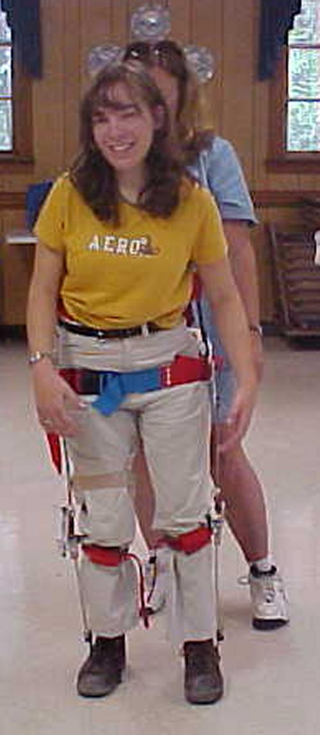
Medical Treatment
Implementation of braces
Physical Therapy
Wheelchair

Slide 11
Goals of Physical Therapy
Strive for muscle balance
Emphasize range of motion
Resistance program
Progression

Slide 12
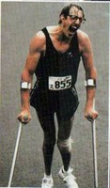
Inspirational Figure
Jerry Traylor

Slide 13
Questions??

Slide 14
References
Dunn, J., & Leitschuh, C. (2006). Special physical education. Dubuque, Iowa: Kendall Hunt.
Bjorklund, R. (2007). Cerebral Palsy. New York, NY: Marshall Cavendish.

