Slide 1


Slide 2

Socioeconomic Status and the Sciences
Dan Barr, Braden Julian, and Emily Ehlerding
Dare you to Move
Switchfoot

Slide 3
What is Socioeconomic Status?
an economic and sociological combined total measure of a person's work experience and of an individual's or family’s economic and social position relative to others, based on income, education, and occupation.¹

Slide 4
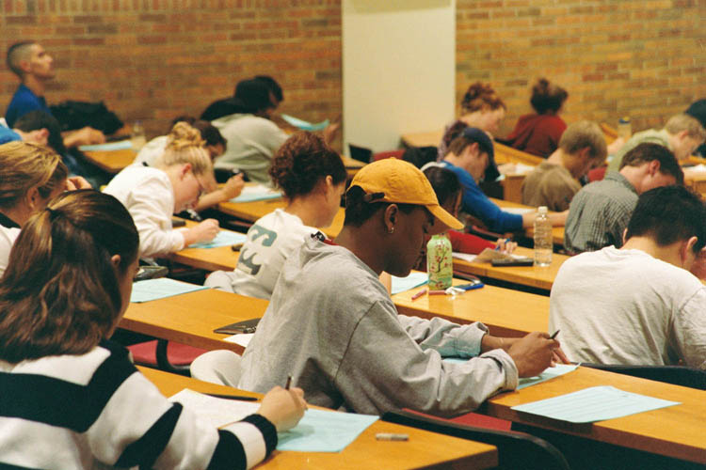

Slide 5
Socioeconomic Levels²

Slide 6
Values by Class - Education
Poverty | Valued and revered as abstract but not as reality.
Middle Class | Crucial for climbing ladder of success and making money.
Wealthy | Necessary tradition for making and maintaining connections.³

Slide 7
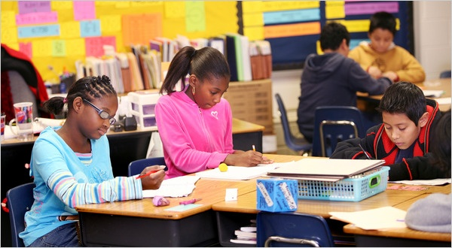

Slide 8
Values by Class –
Time
Poverty | Present most important. Decisions made for moment based on feelings or survival.
Middle Class | Future most important. Decisions made against future ramifications.
Wealthy | Traditions and history most important. Decisions made partially on basis of tradition and decorum.³

Slide 9
Initial Set-Backs
Children’s initial reading and learning competence is linked with home environment and parent distress.⁴
This is due to the amount of resources available to the young children.⁵

Slide 10
Achievement Gaps
Children of poverty generally achieve at lower levels than middle or upper classes.
Factors include learning behaviors, past experiences with education, and teacher attitudes.⁶

Slide 11


Slide 12
“at-risk”
Refers to children who are likely to fail in school or in life because of their life’s social circumstances.
Poverty is considered a major at-risk factor.⁶

Slide 13
Shawnee Middle School
1 : 21 teacher / student ratio
45 % are eligible for free lunch
49.9% passed both Math and English ISTEP+
Shawnee did not make Adequate Yearly Progress in 2009 – 10.⁷

Slide 14
Relations to the Sciences
Science classes require time and good study habits to be successful.
Children need to develop a strong work ethic.
Home environment is crucial to developing these skills.

Slide 15


Slide 16
Relations to the Sciences
As described by the values shown previously, different classes value education differently.
This causes differences in student attitudes, like unwillingness to complete assignments.

Slide 17
What Teachers can do
Have high expectations for all students.
Provide support to students and parents.
Emphasize that each student is unique.
Create an environment and curriculum high in respect, self-esteem, and self-motivation.⁶

Slide 18
References
1.) Merriam-Webster Inc., Initials. (2008, December 11). socioeconomic. Retrieved from http://www.merriamwebster.com/dictionary/socioeconomic
(Merriam-Webster Inc., 2008)
2.) State of Indiana - Div. of IT , Initials. (2010, December 17). Indiana free lunch percent 2009-10. Retrieved from http://mustang.doe.state.in.us/TRENDS/flunch.cfm?year=2010
(State of Indiana - Div. of IT , 2003)
3.) Payne, R. (2001). A framework for understanding poverty. TX: aha! Processes Inc.
4.) State Government of Victoria , Initials. (2009, December 8). Understanding the needs of students from low socio-economic backgrounds. Retrieved from http://www.education.vic.gov.au/management/schooloperations/equity/disadvantage.htm
(State Government of Victoria , 2006)
5.) AmericanPsychologicalAssociation, Initials. (2010, April 20). Fact sheet: education & socioeconomic status. Retrieved from http://www.apa.org/pi/ses/resources/publications/factsheet-education.aspx
(AmericanPsychologicalAssociation, 1992)
6.) Teachnology, Inc., Initials. (2010, April 20). The effects of poverty on teaching and learning . Retrieved from http://www.teach-nology.com/tutorials/teaching/poverty
(Teachnology, Inc., 2010)
7.) Public school review. (2006, October 13). Retrieved from http://www.publicschoolreview.com/school_ov/school_id/27799 http://www.nytimes.com/2010/01/07/us/07south.html?_r=1 http://www.ivillage.com/will-scigirls-help-girls-get-math-and-science/1-a-84463
("Public school review," 2006)
http://www.nytimes.com/2010/01/07/us/07south.html?_r=1
http://www.ivillage.com/will-scigirls-help-girls-get-math-and-science/1-a-84463
http://www.youtube.com/watch?v=fpfpouLHp6c
http://collegelife.freedomblogging.com/2008/07/02/you-should-only-take-it-once-rightnot-anymore/293/

Slide 19


